Slide 1
Challenges for AI Compiler
Jidong Zhai
Tsinghua University
November 14@Hong Kong

Slide 2
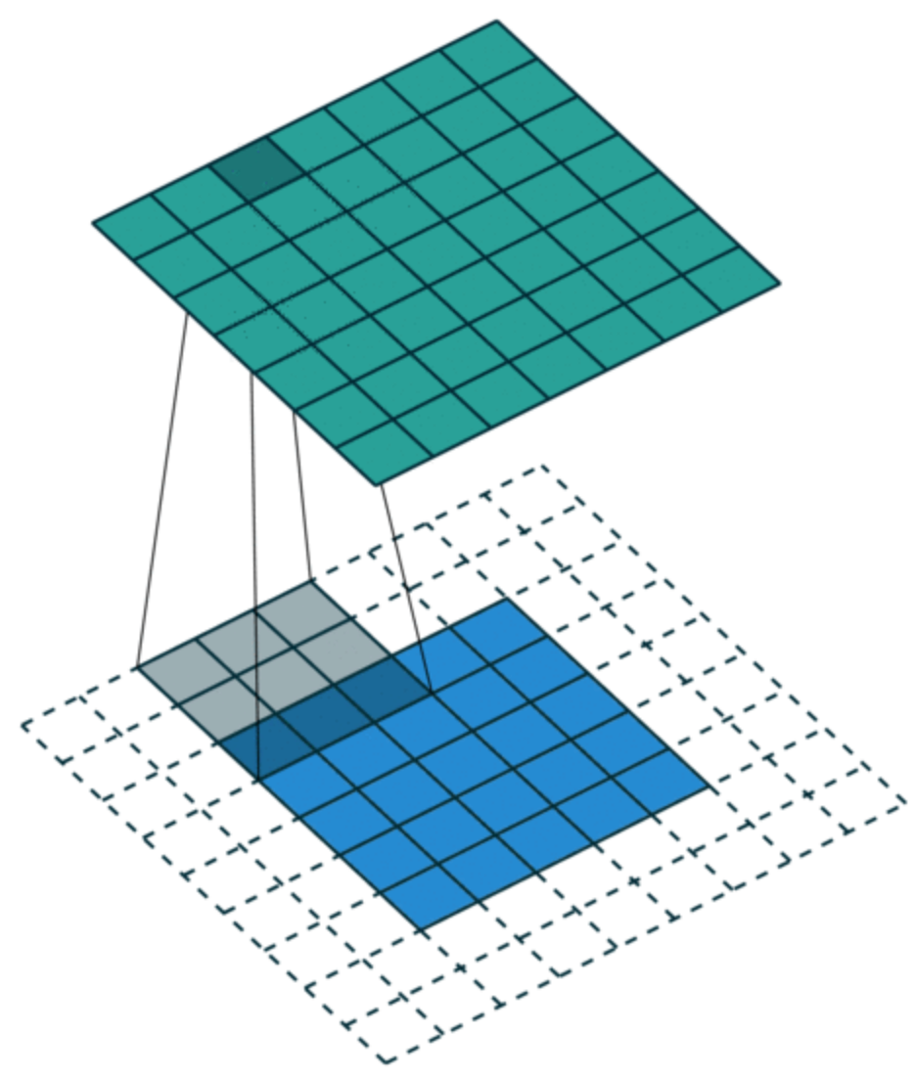
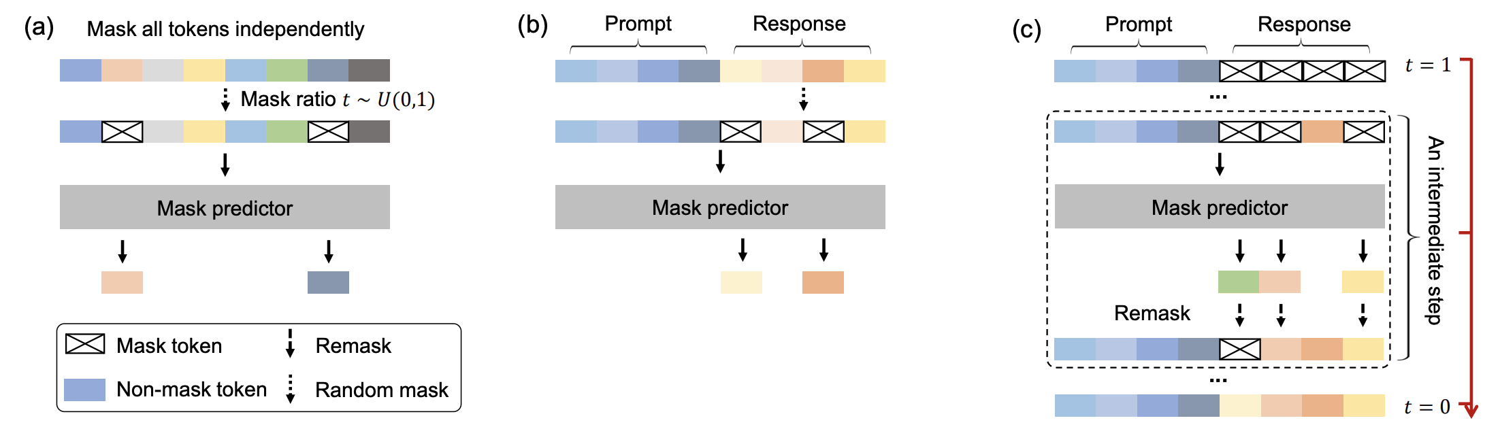
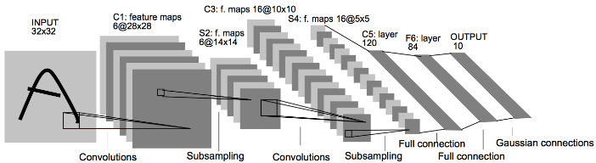
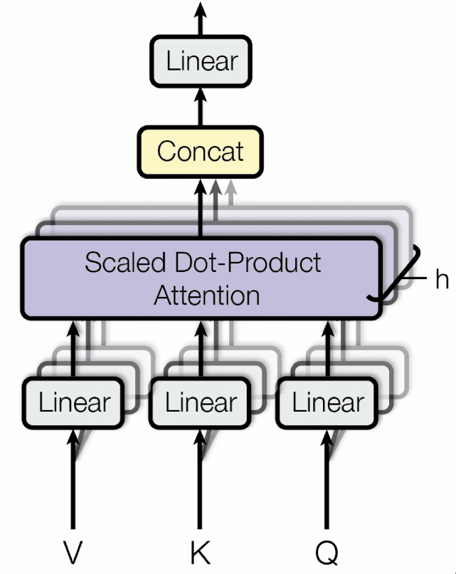
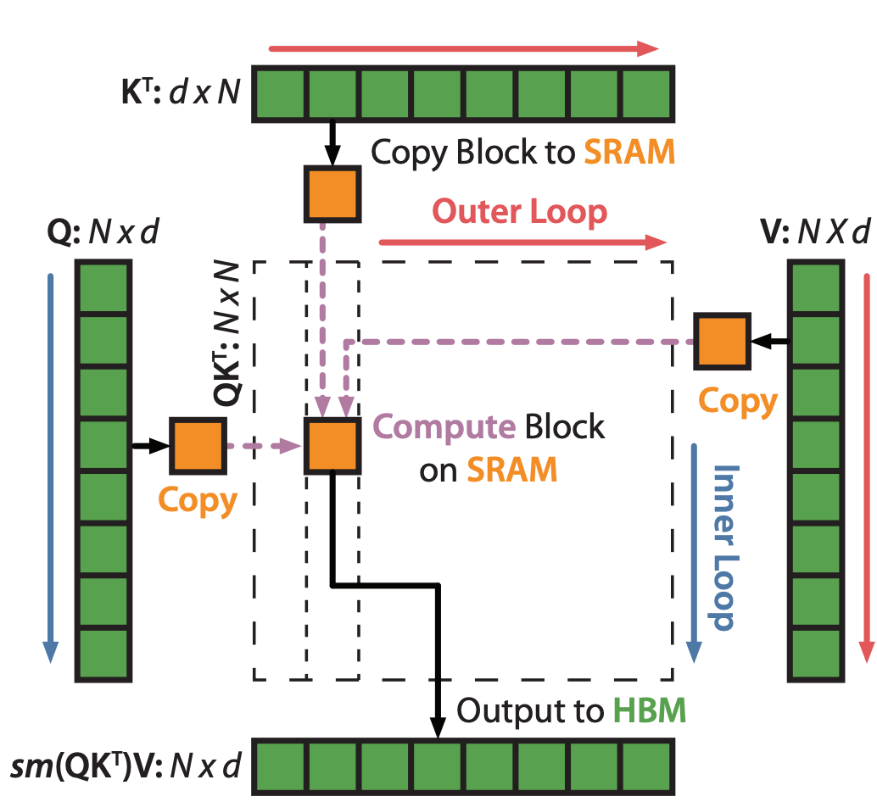
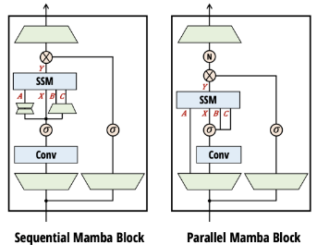
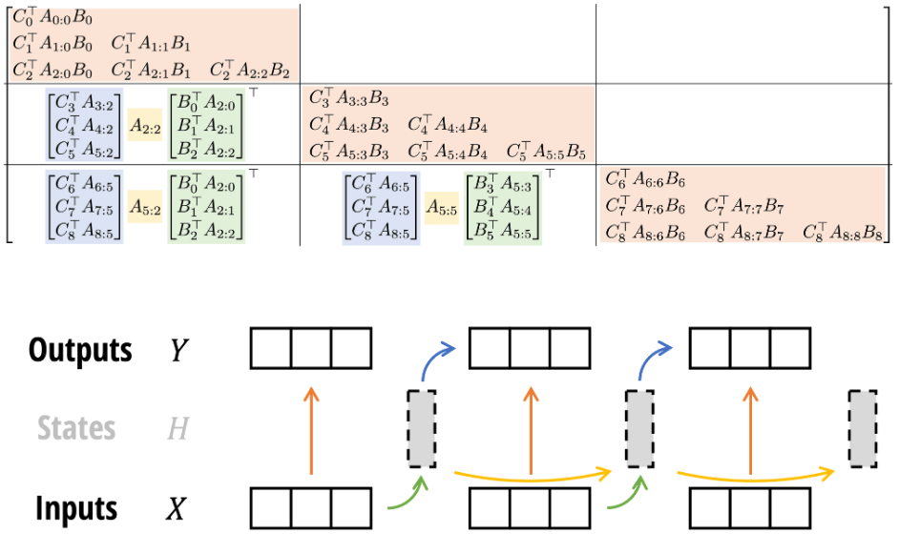
Diverse AI Workloads
Diverse AI workloads have various computation patterns
Convolution
Diffusion Models
Transformer
Linear Attention

Slide 3
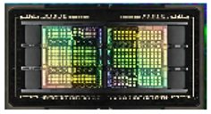
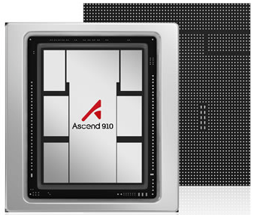
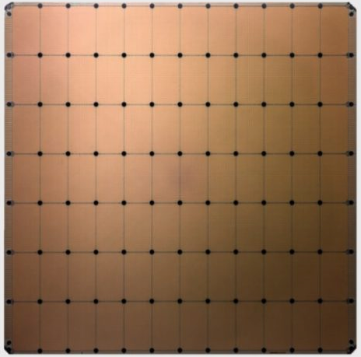
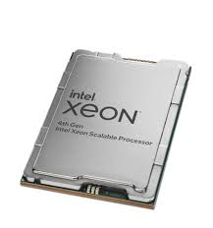
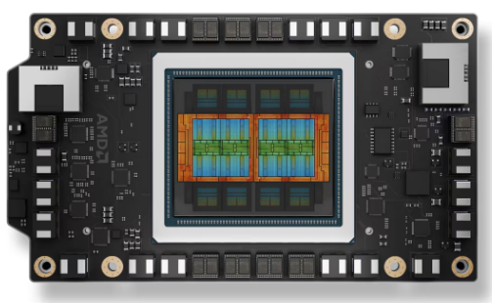
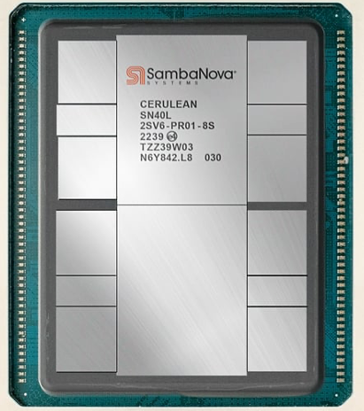
Diverse Hardware Architectures
Diverse hardware architectures adopt different execution models: SIMT, SIMD, Dataflow
SIMT
SIMD
DataFlow
NVIDIA GB200
Ascend 910
Cerebras WSE-3
AMD MI350X
Intel Xeon
SambaNova

Slide 4
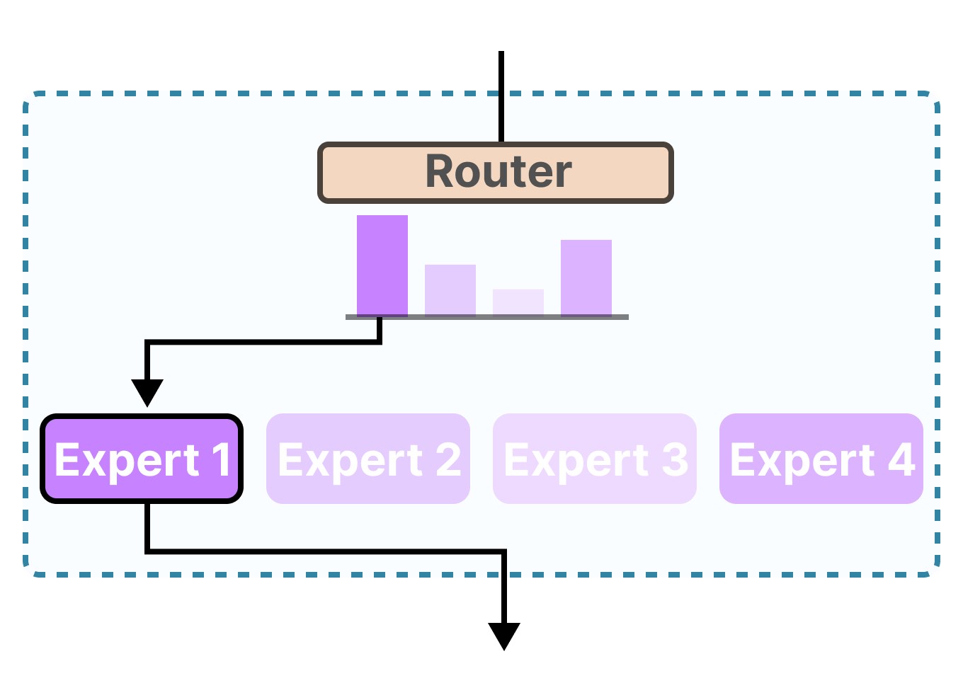
AI Compilers Bridge Models and Hardware
From high-level model into hardware-friendly binaries
Convolution
Transformer
Mixtures of Exports
Linear Attention
AI Compiler
NVIDIA GB200
AMD MI350X
Ascend 910
Intel Xeon
SambaNova
Cerebras WSE-3

Slide 5
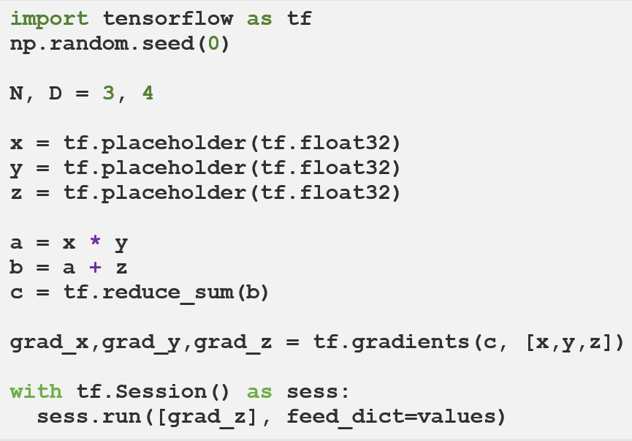


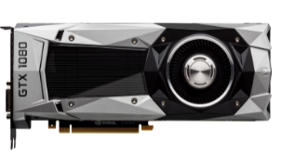


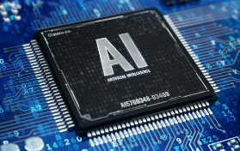
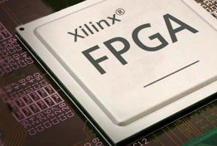
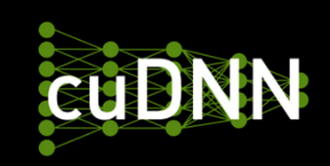
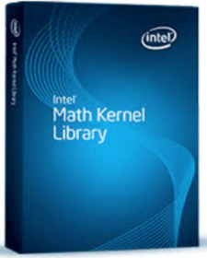
Typical AI Compiler Workflow
Compilation process of deep learning programs
Graph-level optimization on these graphs, such as fusion, fission etc.
Computation
graphs
DL source code
CUDNN, CUBLAS
AI Chips
Operator-level
optimization, such as tiling, reorder, etc.

Slide 6
Challenge Overview
Graph Construction
How to translate a user program into a computation graph
Graph Transformation
How to automatically derive optimized graphs
Operator Description
How to design a frontend for describing operators
Intermediate Representation
How to abstract properties of diverse hardware
Code Generation
How to generate efficient code for sophisticated chips

Slide 7
Challenge Overview
Graph Construction
Graph Construction
How to translate user program into a computation graph
How to translate a user program into a computation graph
Graph Transformation
How to automatically derive optimized graphs
Operator Description
How to design a frontend for describing operators
Intermediate Representation
How to abstract properties of diverse hardware
Code Generation
How to generate efficient code for sophisticated chips

Slide 8


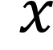
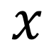
Gap between User Program and AI Compiler
User program: flexible Python + operator library (e.g., PyTorch)
Eager mode without compilation, low performance
AI compiler: to accelerate deep learning programs
Need an operator graph as input
$$x$$
$$x$$
Convolution
def resnet(
self,
x:torch.Tensor
) -> torch.Tensor:
identity = x out = self.conv1(x)
out = self.bn1(out)
out = self.relu(out) out = self.conv2(out)
out = self.bn2(out)
out += identity
out = self.relu(out)
Batch Norm
Conv-BN-
Relu
Relu
Convolution
Batch Norm
Compiler
optimizations
Conv-BN-
Add-Relu
+
Relu

Slide 9
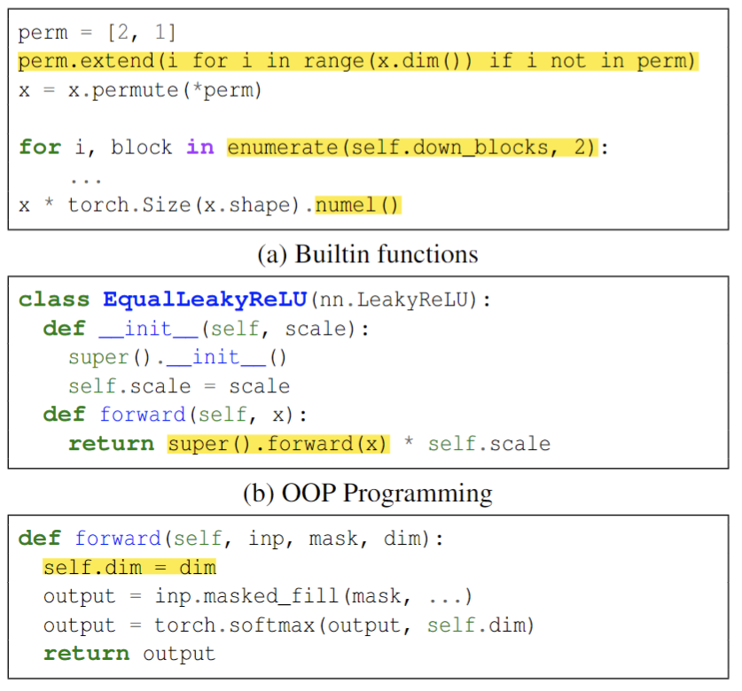
Challenge-1 Language Flexibility
Python is a flexible dynamic language
1. Dynamic Data Type
Type info is not available from source code
2. Diverse Builtin APIs
Containers, iterators …
3. Side effects
ALL examples are from real user code
#1
#2
#3
#4
#1: github.com/LoSealL/VideoSuperResolution
#2: github.com/rawmarshmellows/pytorch-unet-resnet-50-encoder
#3: github.com/bayesiains/nflow
#4: https://github.com/huggingface/transformers

Slide 10
Challenge-2 Dynamic Patterns
Operators may be changed during the execution
E.g., diffusion model uses different LORA adapters to generate images with different styles
layer1
layer2
layer3
class Diffusion(nn.Module):
def __init__(self, ...):
...
def forward(self, x, lora):
for layer in self.layers:
x = layer(x) + lora(x)
return x
layer1
layer2
layer3
lora
lora
lora
layer1
layer2
layer3
Diffusion model
lora
lora
lora
Potential operator graphs

Slide 11

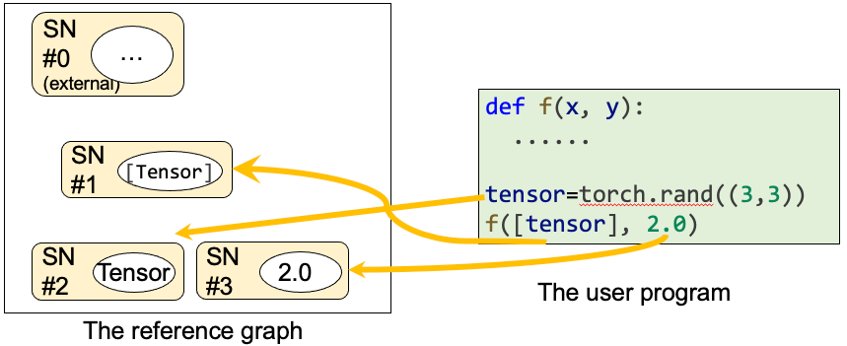
MagPy: Python Interpreter-guided Graph Builder
Leverage Python Interpreter to better understand user program
Generate better computation graphs
Monitor program execution states at runtime
1
2
Python Interpreter
Build Reference Graph containing external values that can affect the graph.
Generage Guard to check graph correctness from a new call.
Support all Python features
Maintain high-level execution information (e.g. values, types)
def guard_f(x, y):
return sn[1].match(x) \
and sn[2].match(x[0]) \
and sn[3].match(y)
Help to know
Will the graph change
When it will change
Chen Zhang, et al. ”MAGPY: Compiling Eager Mode DNN Programs by Monitoring Execution States" ATC. 2024.

Slide 12
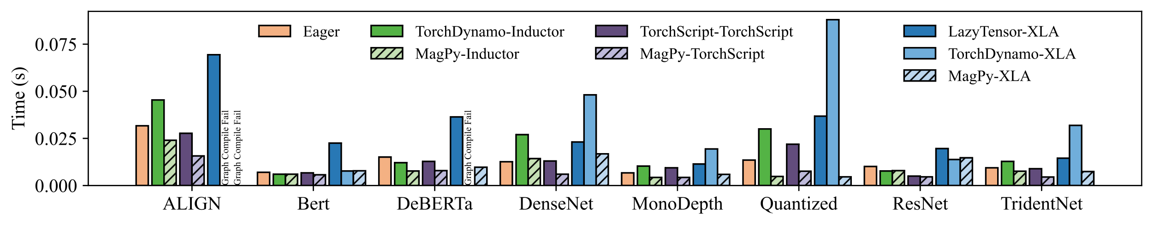
Results of MagPy
Export more models to a full computation graph
Cases | Static cases | Compiler | #. success | Success rate
1421 | 1191 | TorchScript | 422 | 35.4%
 |  | TorchDynamo | 919 | 77.2%
 |  | MagPy | 1112 | 93.4%
Achieve up to 8.00× speedup ( 2.49× on average) on end-to-end evaluation

Slide 13
Challenge Overview
Graph Construction
How to translate user program into a computation graph
Graph Transformation
Graph Transformation
How to automatically derive optimized graphs
How to automatically derive optimized graphs
Operator Description
How to design a frontend for describing operators
Intermediate Representation
How to abstract properties of diverse hardware
Code Generation
How to generate efficient code for sophisticated chips

Slide 14
Common Graph Transformations
Rule-based transformations to optimize program performance
Input
Rule 1: Fuse conv + relu
Input
conv3x3
conv1x1
conv
conv
+ relu
relu
conv3x3 + relu
conv1x1
+ relu
relu
relu
Rule 2: Fuse convs
conv3x3
conv3x3
conv
conv
add
add
add
add
…
conv
relu
relu
Input Program
Program Transformation rules
Optimized Program
Notes:
To optimize the performance of a tensor program, existing approaches use rule-based transformations to optimize program.
Just like this, for this input computation graph, we have a number predefined transformation rules, such as rule 1 and rule 2, then we apply these rules, wo can get a new computation graph.

Slide 15
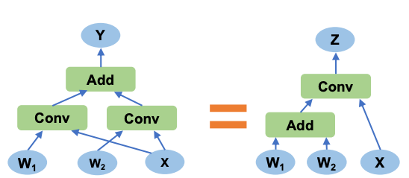
Challenge-1 Limited Transformation Rules
Performance is limited by existing expert-written transformation rules.
Predefined Operator Set
Predefined Transformation Rule
Predefined Operator
General Operator
Conv
Add
Gemm
?
Predefined Rule
General Transformation
Challenge 1: How can we discover new transformation rules automatically?

Slide 16
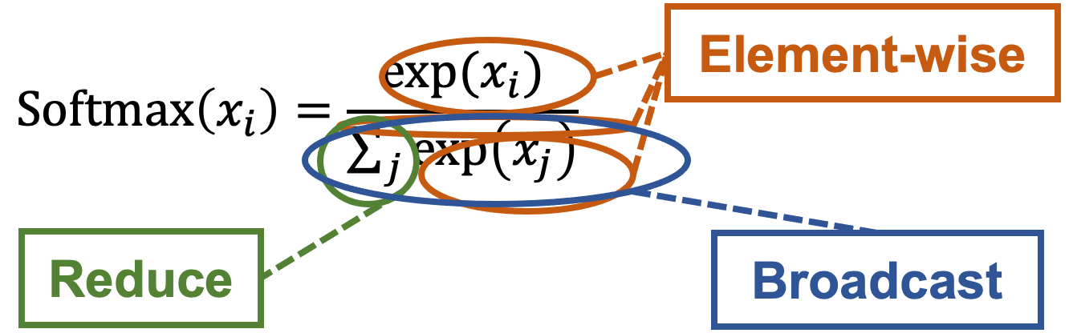
Challenge-2 Complex Computation Graphs
Existing works fail to deal with complex computation graphs
Intra-operator complexity
The operator itself is complex: e.g. SoftMax
Inter-operator complexity
Multiple complex operators introduce complex dependency in graph: e.g. H2O
Div
Add
Softmax
Transpose
MatMul
Reduction on Different Dimension
Input K
const scalar
Mask
Reduce 0
Input V
MatMul 1
Input Q
MatMul 0
Mul
Add
Exp
Div
Reduce 1

Slide 17
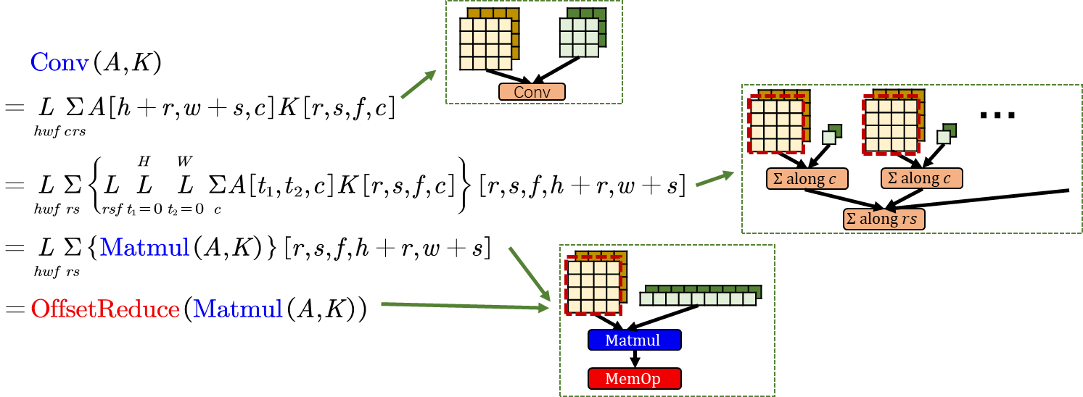
EinNet: Derivation-based optimizer
Express AI models with tensor algebra expressions, and automatically find equivalent transformations by applying linear-algebra based derivation rules.
1
Express DNN programs using tensor algebra expressions
2
Automatically find equivalent transformation by applying derivation rules
4
Automatically generate non-existing operators to guarantee the flexibility
3
Map existing operators to DNN library to guarantee the efficiency
Zheng, Liyan, et al. "EinNet: Optimizing Tensor Programs with Derivation-Based Transformations." OSDI. 2023.

Slide 18
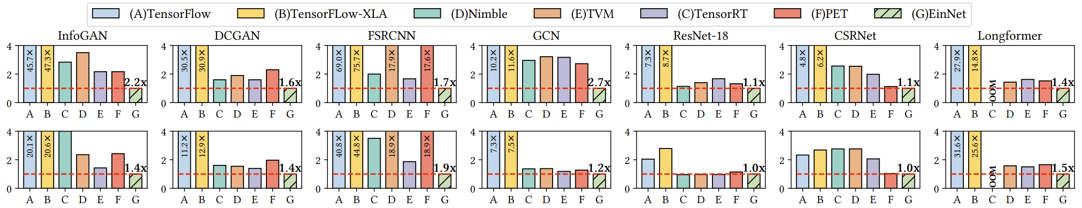
Results of EinNet
Achieve up to 2.7× speedup ( 1.51× on average) on some DNN models

Slide 19
Challenge Overview
Graph Construction
How to translate user program into a computation graph
Graph Transformation
How to automatically derive optimized graphs
Operator Description
How to design a frontend for describing operators
Intermediate Representation
How to abstract properties of diverse hardware
Code Generation
How to generate efficient code for sophisticated chips

Slide 20
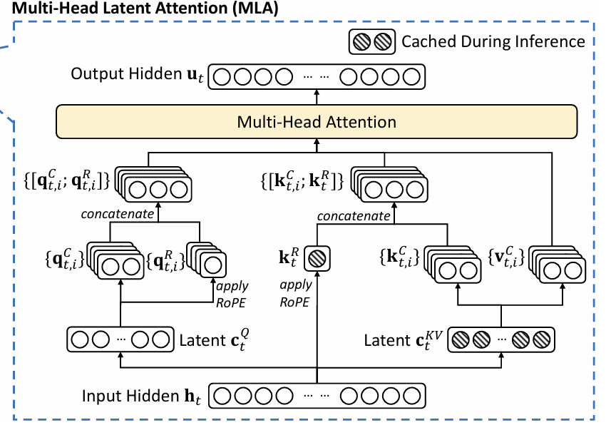
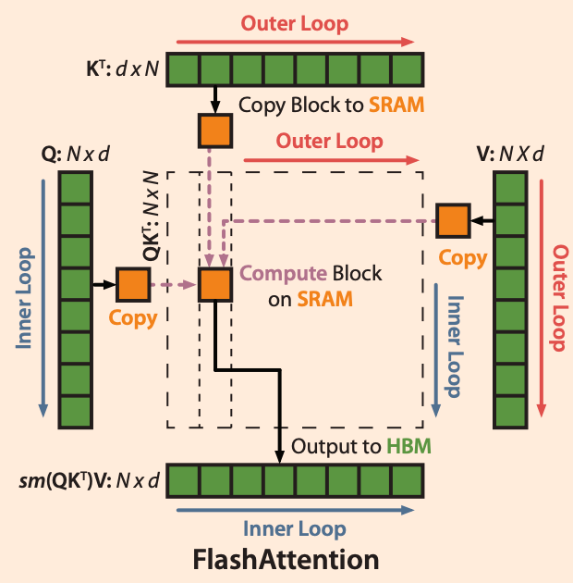
Evolving Demands for New Operator Kernels
Driving Forces
New AI models: linear attention, sparse attention, MoE, …
Generated new operators: kernel fusion techniques (e.g. Flash Attention)
New model structures require custom operator kernels
Kernel fusion delivers
significant performance gains
How do we describe these new operators for efficient code generation?

Slide 21
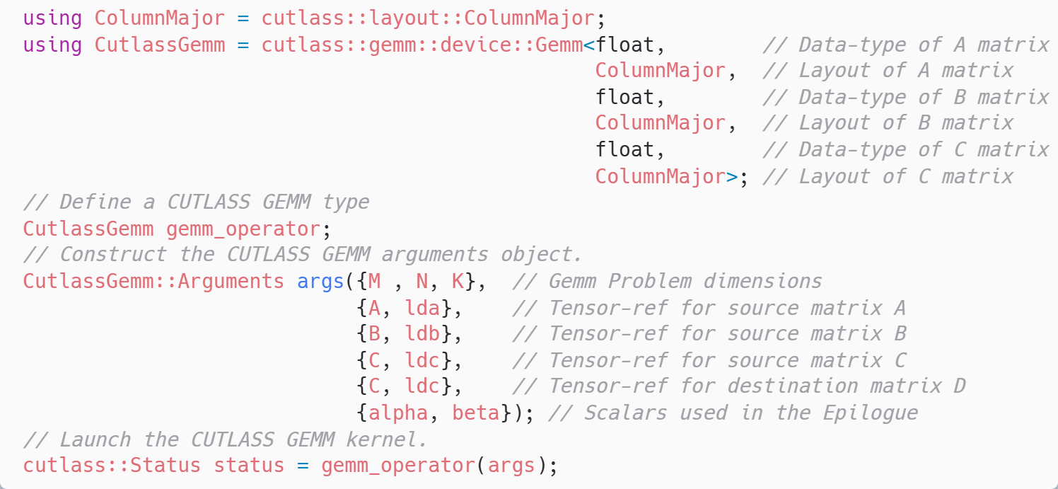
CUTLASS : Template-based Representation
Define a GEMM kernel with template arguments
Relies on predefined templates to describe new kernels
Pro: Delivering high performance with well-developed templates
Con: Programming complexity due to reliance on predefined templates

Slide 22
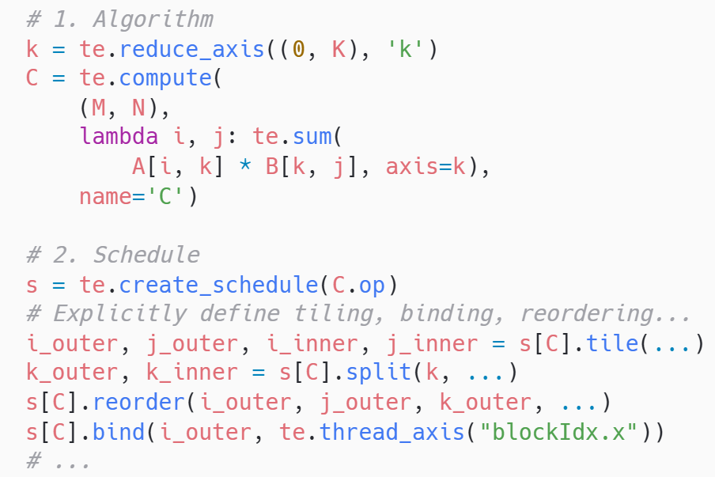
TVM: Einsum Representation
TVM decomposes a program into algorithm and schedule
Algorithm : What is computed
Schedule: How to compute
Pro: Ease of use, with a concise syntax for expressing tensor operations
Con:
work with perfectly nested loops, unable to handle complex tensor programs
writing schedules are also difficult
Matrix Multiplication Example
Algorithm
Schedule

Slide 23
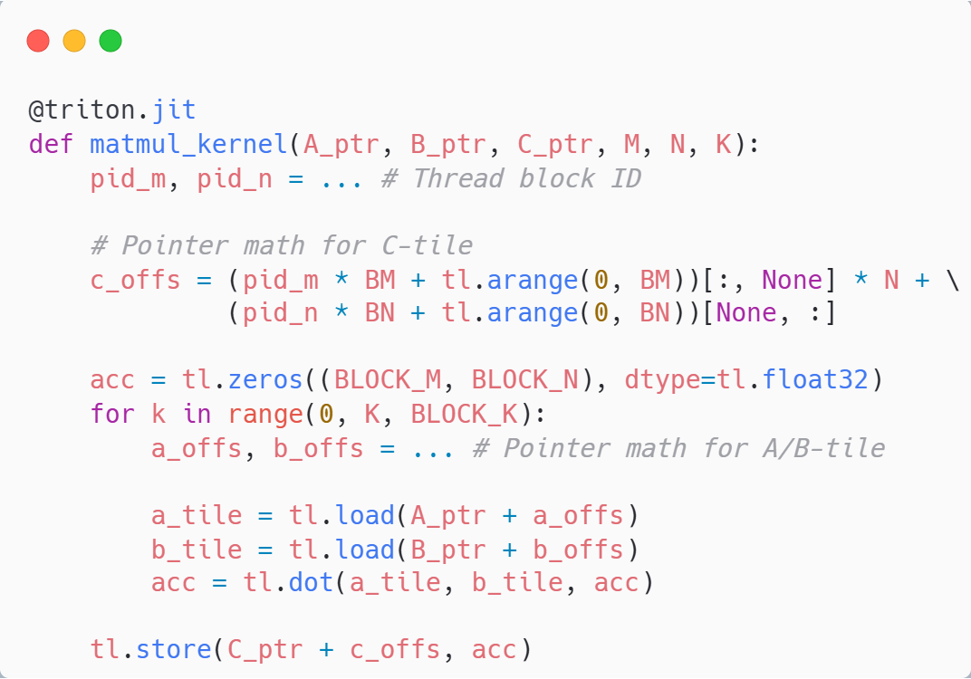
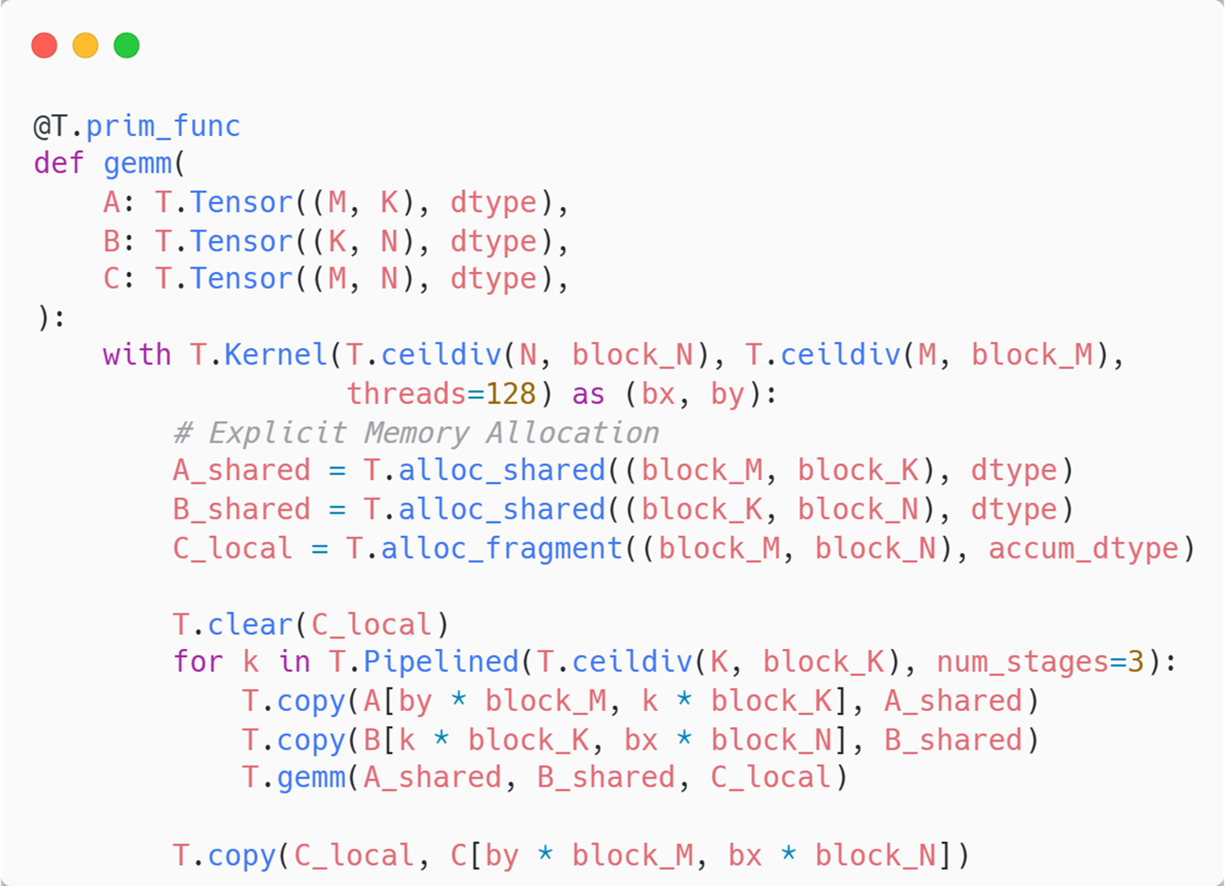
Triton/TileLang: Tile-based Representation
Triton
TileLang
Inner Reduction Loop
Uses tiles as basic building blocks for kernel construction
Pro: Enhance usability, make it easier to express complex tensor operations
Cons: Lack of manual control over the underlying hardware features, resulting in sub-optimal performance

Slide 24
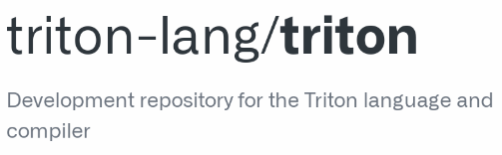

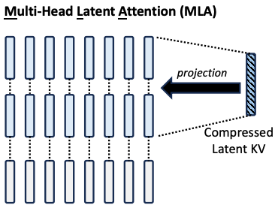
Performance issue in Triton
Performance gap between triton and manual optimization
Multi-Head Latent Attention

Slide 25
Challenge: How to achieve good balance between usability and high-performance
Algorithm
Various operator representations
Template-based Representation
Einsum-based Representation
Tile-based Representation
…
Goals of designing frontend (abstraction) for DSL
Usability: easy to express various operators with minimal effort
High-performance: Enables delivering ultimate performance code
high-level abstraction
- High programmer productivity
- Limited performance potential
Optimal Abstraction
low-level abstraction
- High programming complexity
- Unlocks ultimate performance
Hardware

Slide 26
Challenge Overview
Graph Construction
How to translate user program into a computation graph
Graph Transformation
How to automatically derive optimized graphs
Operator Description
How to design a frontend for describing operators
Intermediate Representation
How to abstract properties of diverse hardware
Code Generation
How to generate efficient code for sophisticated chips

Slide 27
Intermediate Representations in AI Compiler
Intermediate Representations (IRs) in AI compilers provide:
Low-level abstraction for underlying hardware backends
Hardware-independent common optimizations
Triton
Triton IR
TritonGPU IR
Intermediate
Representations
TritonNvidiaGPU IR
TritonAMDGPU IR
LLVM IR
LLVM IR
NVIDIA GB200
AMD MI350X

Slide 28
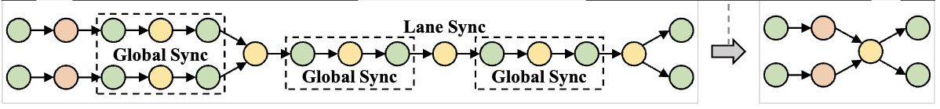
Optimizations over Intermediate Representation
IR provides an interface for optimizations, most of which are shared among diverse AI chips
Traditional compilation optimizations
Inline, CSE, DCE, loop unroll,…
Instruction selection
Memory hierarchy optimizations
Use faster scratched memory (Shared memory)
Instruction reorder
Achieve overlap between computation and memory access
Mul
Add
FMA
CopyIn
Compute
CopyOut
CopyIn
Compute
CopyOut

Slide 29
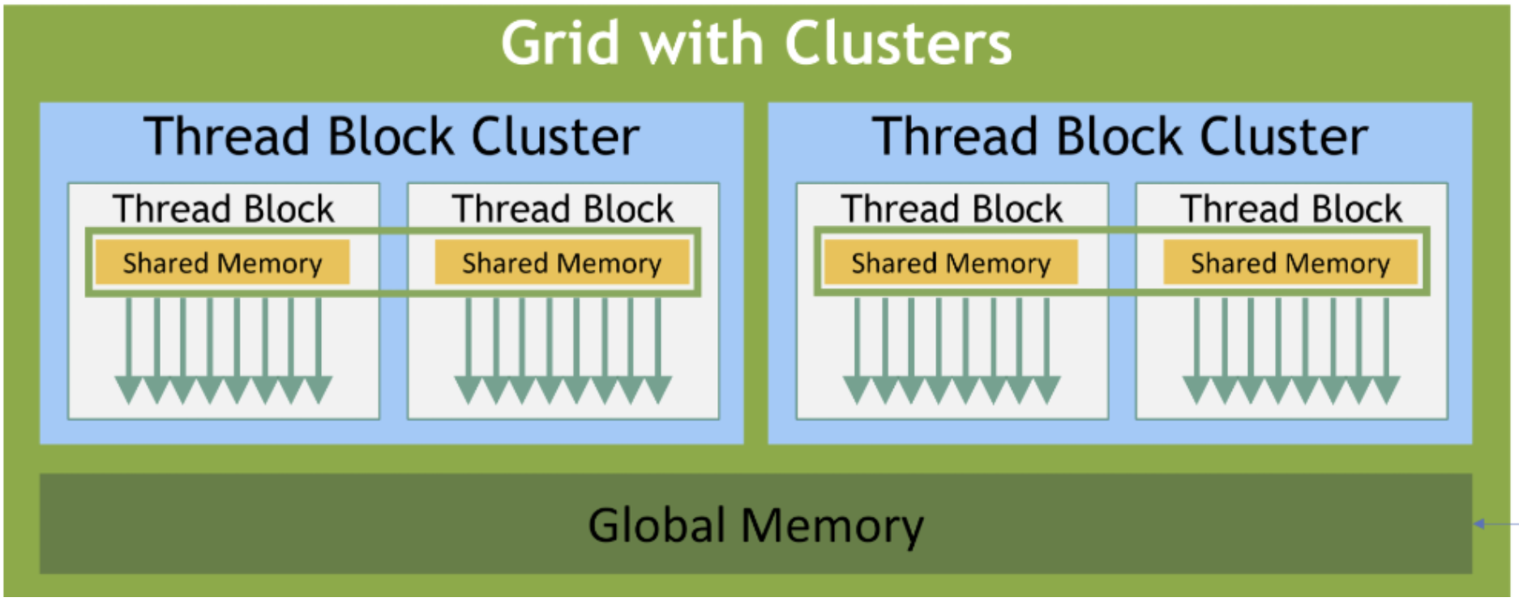
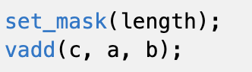
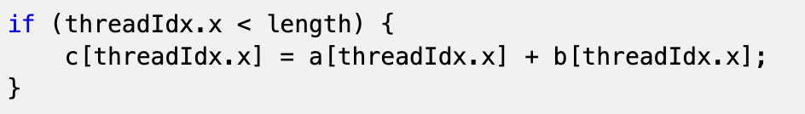
Various Hardware Properties
Different parallelism hierarchies
NVIDIA: thread, warp, thread block, thread block cluster, grid
Ascend: cube core, vector core
Different execution mode
SIMD: Same instructions work on multiple data in parallel
SIMT: Same instructions work across multiple threads with independent control flow and data for each thread
AIC
AIC
AIV
AIV
AIV
AIV
Global Memory
SIMD: controlled by mask
SIMT: controlled by explicit programming

Slide 30
Challenge: A Unified IR for Diverse Hardware
Goal of designing unified intermediate representations (IRs)
Unified abstraction for different architectures (SIMD, SIMT)
Perform most of hardware-agnostic optimizations
User Program
Unified IR
Hardware-agnostic
Optimizations
SIMT
SIMD
DataFlow
NVIDIA GB200
Ascend 910
Cerebras WSE-3

Slide 31
Challenge Overview
Graph Construction
How to translate user program into a computation graph
Graph Transformation
How to automatically derive optimized graphs
Operator Description
How to design a frontend for describing operators
Intermediate Representation
How to abstract properties of diverse hardware
Code Generation
How to generate efficient code for sophisticated chips

Slide 32
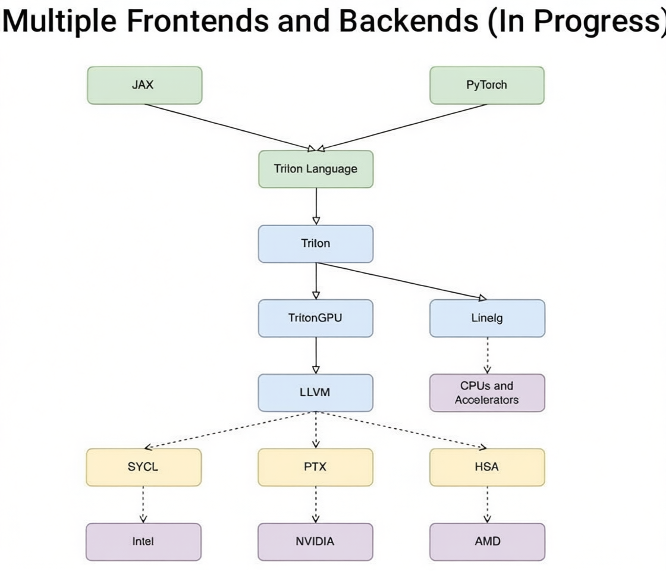
Code Generation: from IR to Binary
The code generation phase generates efficient binaries from IR
Challenges in CodeGen
Sophisticated hardware chips
New hardware components and instructions
Complex data layout requirements
Coordinate multiple hardware units
Software pipeline for multiple hardware units

Slide 33
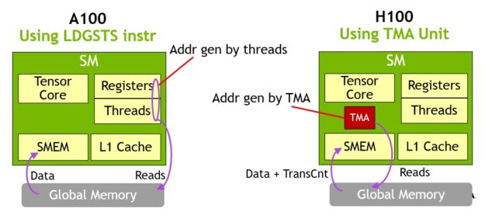
Challenge-1 Sophisticated Hardware Chips
Architectures of AI chips are evolving at a rapid pace
New chips come with new hardware components or instructions
NVIDIA Ampere GPU
Asynchronous copy
NVIDIA Hopper GPU
Distributed Shared Memory, TMA
NVIDIA Blackwell GPU
Tensor Memory

Slide 34
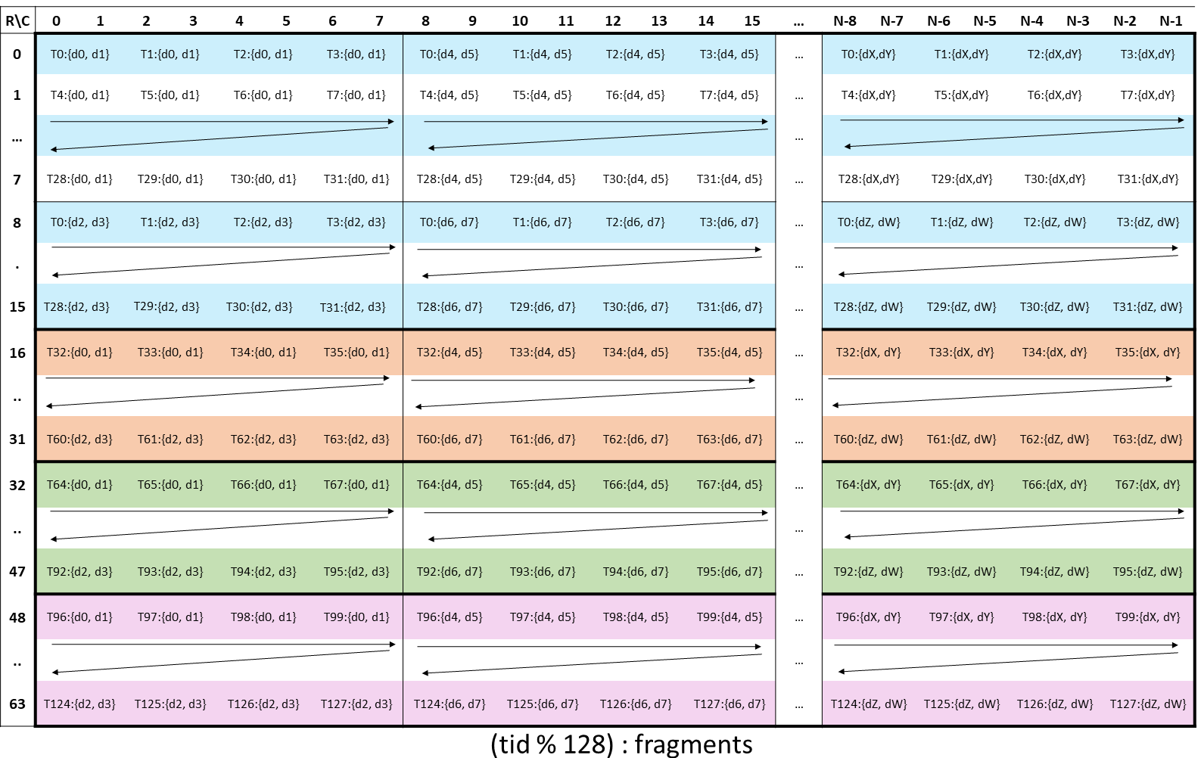
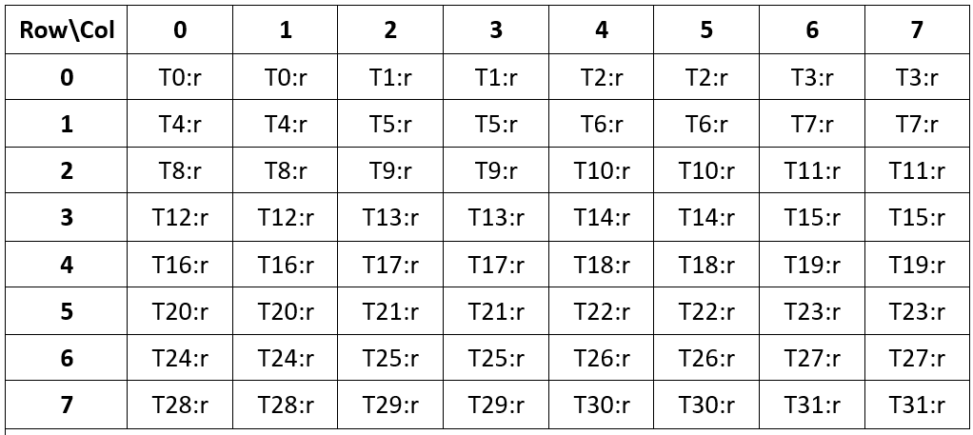
Challenge-1 Sophisticated Hardware Chips
Some instructions have strict data layout constraints
E.g., Data should be distributed among threads in tensor core
Challenge 1: How do we effectively utilize each complex hardware unit?

Slide 35
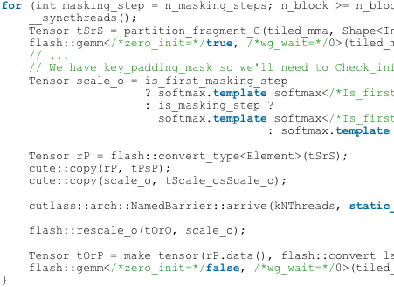
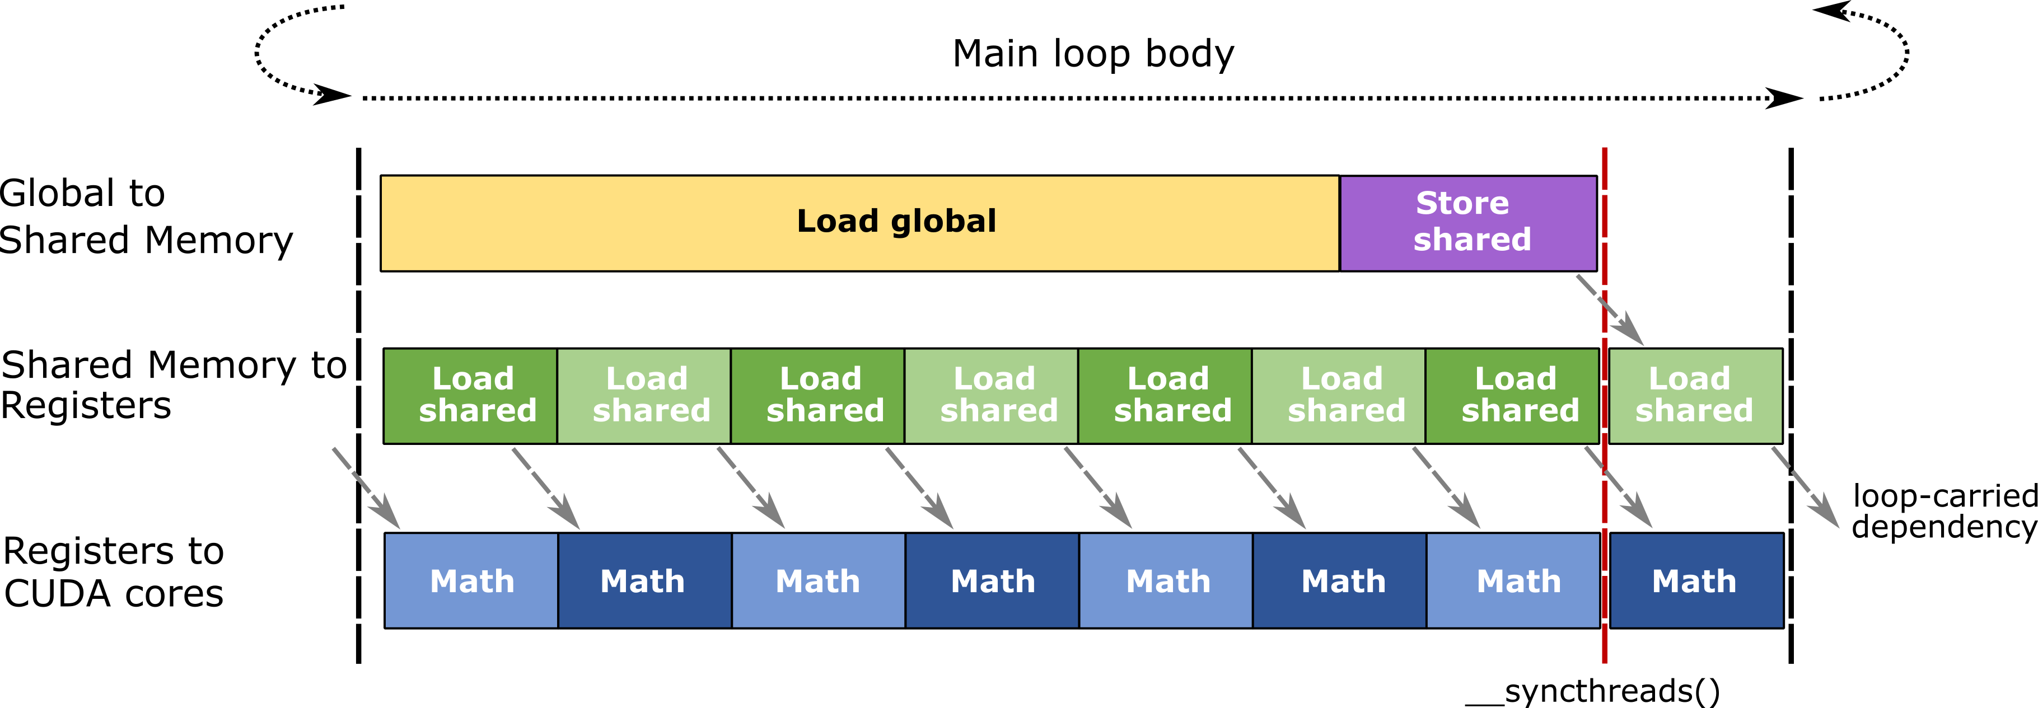
Challenge-2 Coordinate Multiple Hardware Units
Multiple function and acceleration units in AI chips:
Memory and compute units
Matrix core and vector core
Memory operation
FlashMLA
Compute operation
Challenge 2: How to coordinate multiple hardware units for peak performance

Slide 36
Summary of Challenges
Graph Construction
How to translate a user program into a computation graph
Graph Transformation
How to automatically derive optimized graphs
Operator Description
How to design a frontend for describing operators
Intermediate Representation
How to abstract properties of diverse hardware
Code Generation
How to generate efficient code for sophisticated chips

Slide 37







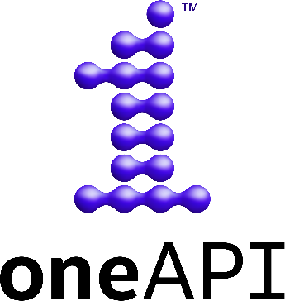

Research about Our Group
System For AI
Our work
Parallelism
Megatron-LM
SmartMoE
Programing
Framework
UniQ
Communication Libs
NCCL
Operator
Library
cuBLAS
cuDNN
AI Compiler
PET
EinNet
FlashTensor
Programing
Language
Underlying
Systems
Spread-n-share
Memory
Self Checkpoint
Storage
37

Slide 38






Chitu: An Open-Source LLM Inference System
https://github.com/thu-pacman/chitu
Key
techniques
Compilation Optimization，FP4/FP8 Inference Optimization，Parallelism Tuning, Mixed Precision
Scalable
CPU, GPU, CPU+GPU
Single-GPU deployment, Large-scale cluster deployment
Optimized for quantized models
LLM serving on diverse hardwares

Slide 39

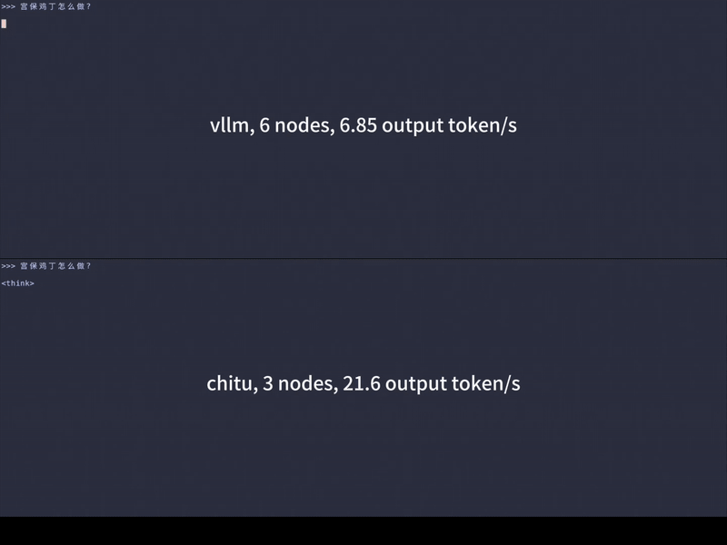
Chitu Results – 赤兔
DeepSeek-R1 | vLLM | Chitu
Size | 671B | 671B
Data Type | BF16 | FP4
Hardware | 32*910B | 8*910B
MMLU Score | 89.8 | 88.0
Speedup | 1.00x | 3.26x
Chitu on A100
Chitu on Ascend

Slide 40

PACMAN
Thank you!
pacman.cs.tsinghua.edu.cn
Jidong Zhai
zhaijidong@Tsinghua.edu.cn

